Slide 1
Home
V i v i a n M a r r a n
Sign in
Create Tourney
Find Tourney

Slide 2
Home
V i v i a n M a r r a n
Sign in
Post Your Tournament
Step 1:
What Game
BANK POOL
8-BALL
9-BALL
10-BALL
ONE POCKET
STRAIGHT POOL
Other
Continue

Slide 3
Home
V i v i a n M a r r a n
Sign in
Post Your Tournament
Step 2:
Full Field
2 MAN
4 PLAYERS
8 PLAYERS
16 PLAYERS
32 PLAYERS
64 PLAYERS
Other (eg. 30, 96, 128)
Continue

Slide 4
Home
V i v i a n M a r r a n
Sign in
Post Your Tournament
Step 3:
Establishment
Eg. Red Shoes Billiards
Continue

Slide 5
Home
V i v i a n M a r r a n
Sign in
Post Your Tournament
Step 4:
Date
Eg. 3/4/2015
Continue

Slide 6
Home
V i v i a n M a r r a n
Sign in
Post Your Tournament
Step 5:
Entry Fee (dollars)
$
Green Fees Included
Continue

Slide 7
Home
V i v i a n M a r r a n
Sign in
Post Your Tournament
Step 6:
Added Money (based on full field)
NO
YES
$$
Continue

Slide 8
Home
V i v i a n M a r r a n
Sign in
Post Your Tournament
Step 7:
Format
Eg. Double Elimination, Full Rack, Race to 23.
Continue

Slide 9
Home
V i v i a n M a r r a n
Sign in
Post Your Tournament
Step 8:
Contact Info (tournament director)
NAME
PHONE
EMAIL
Continue

Slide 10
Home
V i v i a n M a r r a n
Sign in
Post Your Tournament
Step 9:
Start Time
Eg. 12:00pm (noon)
Continue

Slide 11
Home
V i v i a n M a r r a n
Sign in
Post Your Tournament
Step 10:
Preview Your Post
Red Shoes Billiards will be hosting a BANK POOL TOURNAMENT on Saturday March 14th, 2015. This is a $50 entry fee (green fee included), ***$500 ADDED MONEY***(based on a full field), Double Elimination, One Day ("IRON MAN") event. For additional information CONTACT: John Lavin @ Red Shoes Billiards 12009 S. Pulaski Rd. Alsip, Illinois 60803 (tel.708-388-3700 or website: redshoesbilliards.com). Sign-up 12:00PM (noon)
Continue
EDIT

Slide 12
Home
V i v i a n M a r r a n
Sign in
Post Your Tournament
ALMOST DONE!!
Continue

Slide 13
Home
V i v i a n M a r r a n
Sign in
Post Your Tournament
Step 11:
Title (Optional)
Eg. APA Singles Board, NE JOSS 9-Ball Tour, Fight Night – Him vs. HIm
Continue

Slide 14
Home
V i v i a n M a r r a n
Sign in
Post Your Tournament
Step 12:
Additional Information (Optional)
Eg. Comments, Notifications, Instructions from the Tournament Director
Continue

Slide 15
Home
V i v i a n M a r r a n
Sign in
Post Your Tournament
Step 13:
Confirm Your Post
TITLE
Red Shoes Billiards will be hosting a BANK POOL TOURNAMENT on Saturday March 14th, 2015. This is a $50 entry fee (green fee included), ***$500 ADDED MONEY***(based on a full field), Double Elimination, One Day ("IRON MAN") event. For additional information CONTACT: John Lavin @ Red Shoes Billiards 12009 S. Pulaski Rd. Alsip, Illinois 60803 (tel.708-388-3700 or website: redshoesbilliards.com). Sign-up 12:00PM (noon)
Confirm and Post
EDIT

Slide 16
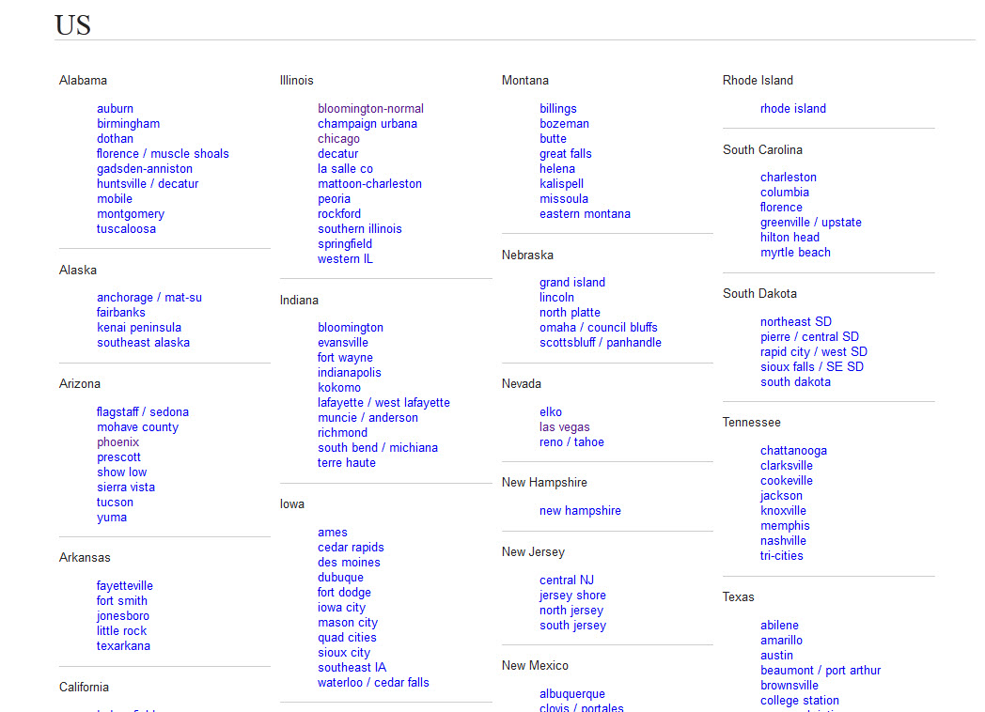
Home
V i v i a n M a r r a n
Sign in
Find Your Tournament

